Slide 1
Ads & Consumerism
Alex, Ashley, Caitlin, Jenn, & Mat.

Slide 2
Why is Doing Critical Analysis on Media Important?
Advertisements are a part of our lives today
Yankelovich a market research group has suggested that “we've gone from being exposed to about 500 ads a day back in the 1970's to as many as 5,000 a day today.”
http://www.cbsnews.com/8301-3445_162-2015684.html
We live in a consumer driven culture, and therefore we need to educate ourselves about what we are really buying and the effects it has on our society and our global environment.

Slide 3
Social Learning Theory
According to this theory people are more likely to act in ways that they see modeled.
Based on this theory, we can understand that advertising companies are intentionally creating their ads with certain underlying messages to best sell their products.
Therefore it is important for us to critically analyze media so we can be aware of its influence
Arnett, Jeffery. Adolescence and Emerging Adulthood: A Cultural Approach. New Jersey: Prentice Hall. (2010). 337-343.

Slide 4
Bloom’s Taxonomy
http://www.celt.iastate.edu/teaching/RevisedBlooms1.html
Knowledge Dimension | Cognitive Process Dimension
Factual- The basic elements Conceptual The interrelationships among the basic elements within a larger structure that enable them to function together Procedural How to do something, Metacognitive Awareness of knowledge You know that you know it | Remember Ability to retrieve fact from memory Understand Construct meaning from instructional messages Apply Carry out tasks or procedure Analyze Break whole into basic elements and determine how parts relate to one another and to an overall structure or purpose Evaluate Make judgments based on criteria or standards. Create Put elements together to form a coherent whole

Slide 5
Developing Critical Analysis Questions Based on Bloom’s
Knowledge
Tell, list describe, relate, state and name
i.e. List what you see in the advertisements
Comprehension
Explain, interpret, outline, discuss, distinguish, predict, compare
i.e. Compare the different images in the advertisements
Application
Show, use, examine, classify
i.e. Classify the advertisements based on the messages

Slide 6
Analysis
Analyze, distinguish, compare and contrast, identify, explain
i.e. Identify the implied messages
Synthesis
Predict, plan, design, imagine, propose, formulate
i.e. Predict the effects these messages could have
Evaluation
Judge, decide, justify, debate, assess
i.e. Assess the best way to be aware of the potential effects advertisements could have on you and others

Slide 7
Five Uses of Media
Jeffery Arnett identified the five uses of media by adolescents/young adults to be:
Entertainment
Identity Formation
High Sensation
Coping
Youth Culture Identification
Arnett, Jeffery. Adolescence and Emerging Adulthood: A Cultural Approach. New Jersey: Prentice Hall. (2010). 337-343.

Slide 8
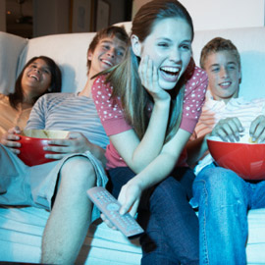
Entertainment
Music, television shows, movies, magazines, etc. are all used by adolescents (as well as adults and children) for entertainment and recreation.
Arnett, Jeffery. Adolescence and Emerging Adulthood: A Cultural Approach. New Jersey: Prentice Hall. (2010). 337-343.

Slide 9
Identity Formation
Adolescence is a time for identity formation: developing of values, abilities, and hopes for the future. Media plays a large role in influencing these factors:
The “Ideal” and the “Feared”
Gender Role Identity
Arnett, Jeffery. Adolescence and Emerging Adulthood: A Cultural Approach. New Jersey: Prentice Hall. (2010). 337-343.

Slide 10
High Sensation
Sensation seeking: “a personality trait defined by the novelty and intensity of a sensation…overall, sensation seeking is related to higher media consumption in adolescence”.
This trait is commonly found in adolescents and young adults.
i.e. The audiences of action films are highly populated by young males because they are the population that generally seeks out high sensation factors (explosions, gun fire, car chases, etc.) This is why video games are often highly violent. ENFORCING GENDER ROLES.
Arnett, Jeffery. Adolescence and Emerging Adulthood: A Cultural Approach. New Jersey: Prentice Hall. (2010). 337-343.

Slide 11
Coping
Several studies have indicated that adolescents use media to cope with negative emotions.
Connecting lyrics to their life
Adolescent fans of heavy metal claim that music has the effect of eliminating their anger and calming them down
Television is also used for coping as a way to get away from stressful emotions that have formed throughout the day
Arnett, Jeffery. Adolescence and Emerging Adulthood: A Cultural Approach. New Jersey: Prentice Hall. (2010). 337-343.

Slide 12
Youth Culture Identification
Media gives adolescents a sense of belonging to a youth culture or sub-culture that they can identify with.
If an adolescent is interacting with a new group of adolescents, they can find belonging in that the group has likely watched the same new popular movie, television show, music video, etc.
Youth culture can be divided into sub-cultures that are more specific such as “punk”.
Arnett, Jeffery. Adolescence and Emerging Adulthood: A Cultural Approach. New Jersey: Prentice Hall. (2010). 337-343.

Slide 13
Teaching critical media skills is important, especially for adolescents who are exposed to so many advertisements which enforce social constructs that can drastically shape their identities.
If our goal for educating is focused on students developing critical thinking skills, then we should provide them with tools that allow them to recognize how media and marketing target specific audiences with the intention of reinforcing social constructs.
As a result, students can enter into adulthood as life-long learners and active community members constantly challenging the existence of social constructs.

Slide 14
Group Work
For this activity, please join up with your presentation group!
Using Bloom’s Taxonomy as a framework, discuss the advertisement/product your group has been given.
Knowledge → Comprehension →Application →Analysis → Synthesis → Evaluation.
Thing to discuss:
Who is being targeted? Which (if any) of the five uses of media is being used?
What sort of effect (i.e. enforcing gender roles) does this ad/product have?

Slide 15
If You Use This Activity With Your Future Students…
Instead of giving them advertisements/products like we did for you, take your students to a store/mall and get them to take pictures of what they can find, and then do the follow-up Bloom’s Taxonomy activity.

Slide 16
Adbusters
Official Website
Adbuster Spoof Ads
Tools for Activists & Educators
Pamphlet
Leaflet

Slide 17
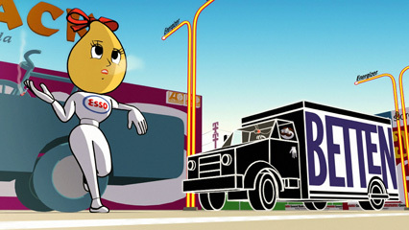
Logorama
Alaux, F. (Director). (May 20, 2011). Logorama [Motion picture]. France: Autour de Minuit Productions.
This film won an Academy Award in 2010 for short film.
It is only sixteen minutes long and is a great film to show in the classroom as an introduction to corporate media and consumerism.
http://vimeo.com/10149605

Slide 18
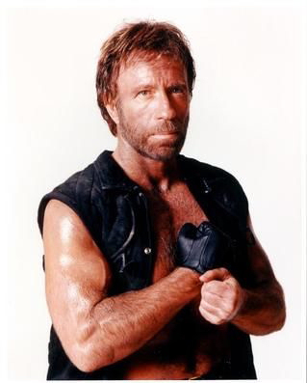
Tough Guise
Katz, J. (Director). (2002). Tough guise [Documentary]. United States: Media Education Foundation.
Jackson Katz, an anti-violence educator, shows his audience how and why the media is responsible for the construction of masculinity and how it affects males and females.
The film analyzes how society, community, family, and the media influence the construction of masculinity.
http://www.youtube.com/watch?v=3exzMPT4nGI
(45-2:30)

Slide 19
The Greatest Movie Ever Sold
Spurlock, M. (Director). (January 22, 2011). The greatest movie ever sold [Documentary]. United States: Sony Pictures Classics.
This documentary describes product placement, advertising, and marketing; in fact, the movie itself is funded by product placement, advertising, and marketing.
The audience is shown the complete marketing process and is taken behind the scenes to see how and why advertising and marketing companies target individuals.

Slide 20
The Story of Stuff
Leonard, A. (Director). (December 4, 2007). The story of stuff. [Documentary]. United States: Free Range Studios.
This animated documentary is a twenty minute film that teaches the audience about the lifecycle of goods and how it affects the environment.
The film puts forth the environmental and social issues that are a direct cause of a society so centered around buying, throwing out, and getting new “stuff”.
http://www.youtube.com/watch?v=gLBE5QAYXp8
(19 min)

Slide 21
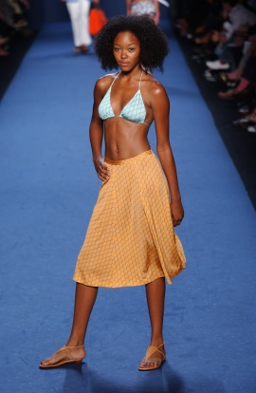
America The Beautiful
Roberts, D. (Director). (2007). America the beautiful [Documentary]. United States: Distributed by Xenon Pictures.
This film provides a very critical eye to the unattainable images of female beauty that are portrayed in the media.
These very images of perfection contribute to the astronomical percentages of women who suffer from low
self-esteem, depression, and eating disorders.
http://www.youtube.com/watch?v=N8i1kEje950

Slide 22
Consuming Kids
Barbaro, A. (Director). (2008). Consuming kids [Documentary]. United States: Media Education Foundation.
Health care professionals, child advocates, and industry insiders uncover for the audience that children are one of the most powerful and profitable consumer demographics in the world because of their purchasing power and purchasing influence over adults.
http://topdocumentaryfilms.com/consuming-kids/
(3:30- 5:50)

Slide 23
SURPRISE!
http://teachingcriticalmediastudies.weebly.com/

